Slide 1
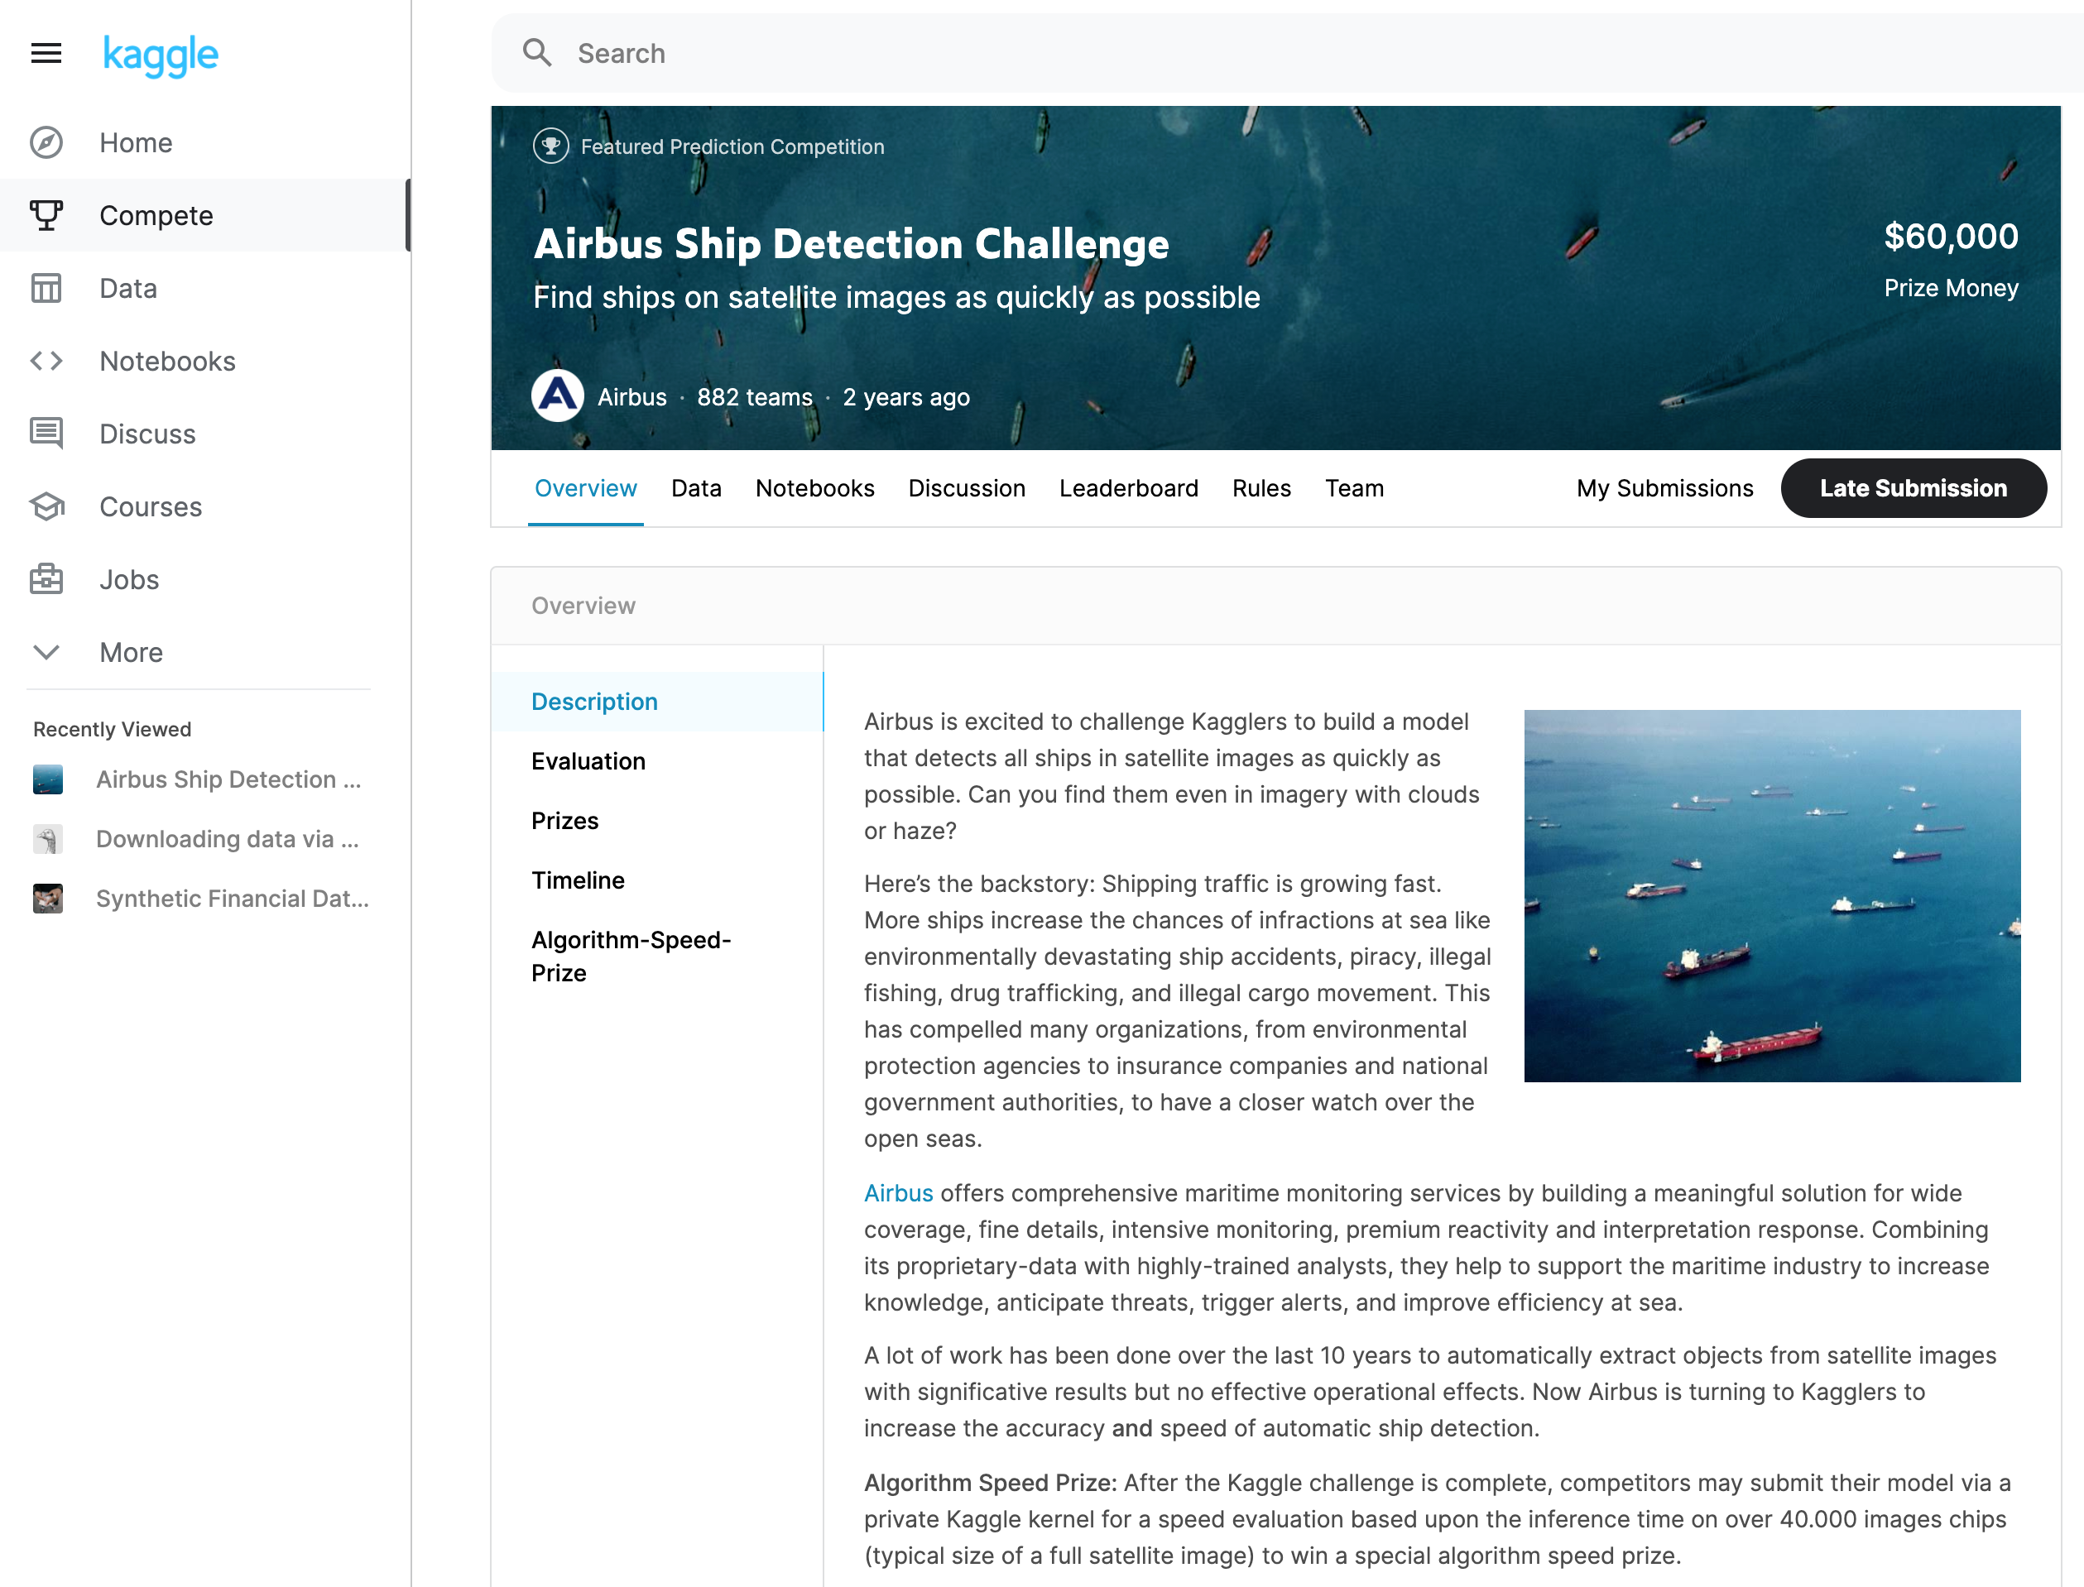
References
Airbus Ship-Data
Source: Architecting ML on AWS:
Write-Up:https://github.com/aws-samples/amazon-sagemaker-architecting-for-ml/blob/master/Writeups/Object%20Detection.md
Starter Code: https://github.com/aws-samples/amazon-sagemaker-architecting-for-ml/blob/master/Starter-Code/ship-data-transformation.ipynb

Slide 2
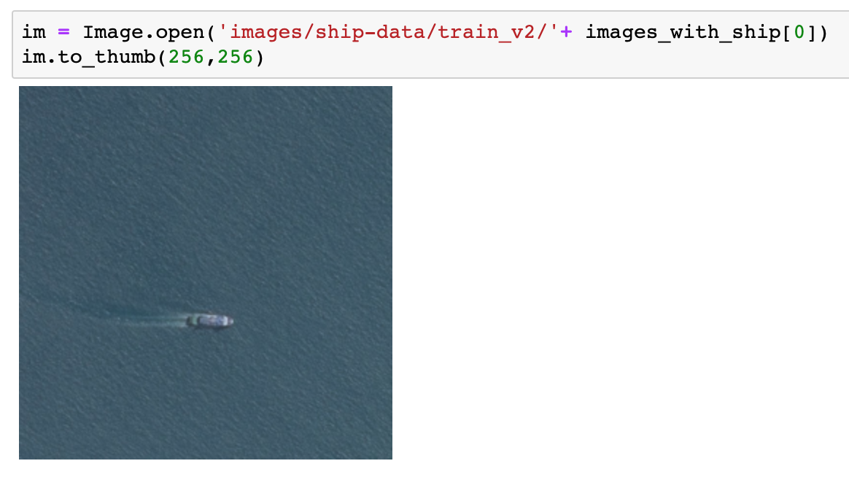
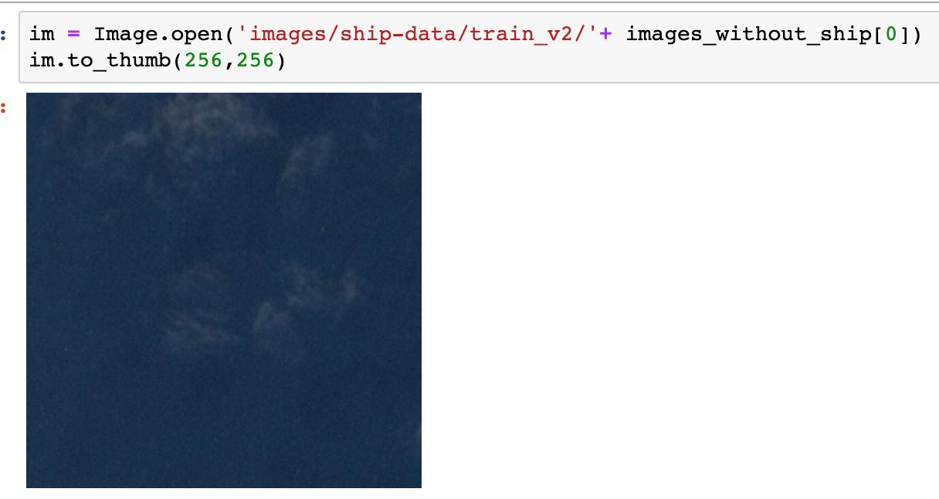
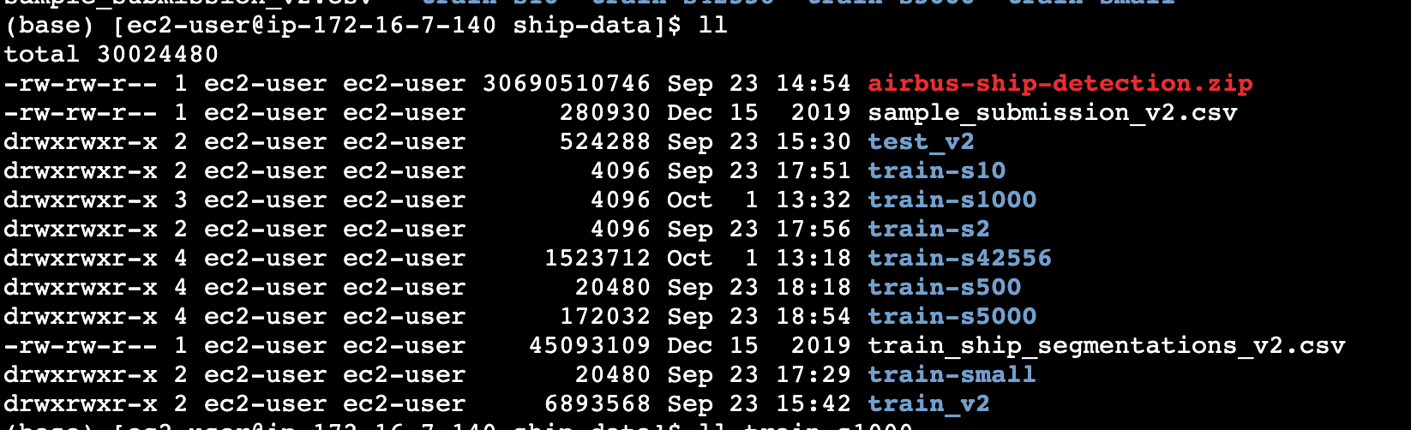
Data Prep (5K images from each)
There are 42556 image files with masks
There are 150.000 image files with NO masks
In total ~200K images
Path('images/ship-data/train-s5000')
Path('images/ship-data/train-s5000/shipyes/0eba89c17.jpg')
Path('images/ship-data/train-s5000/shipno/07987cdc3.jpg')

Slide 3
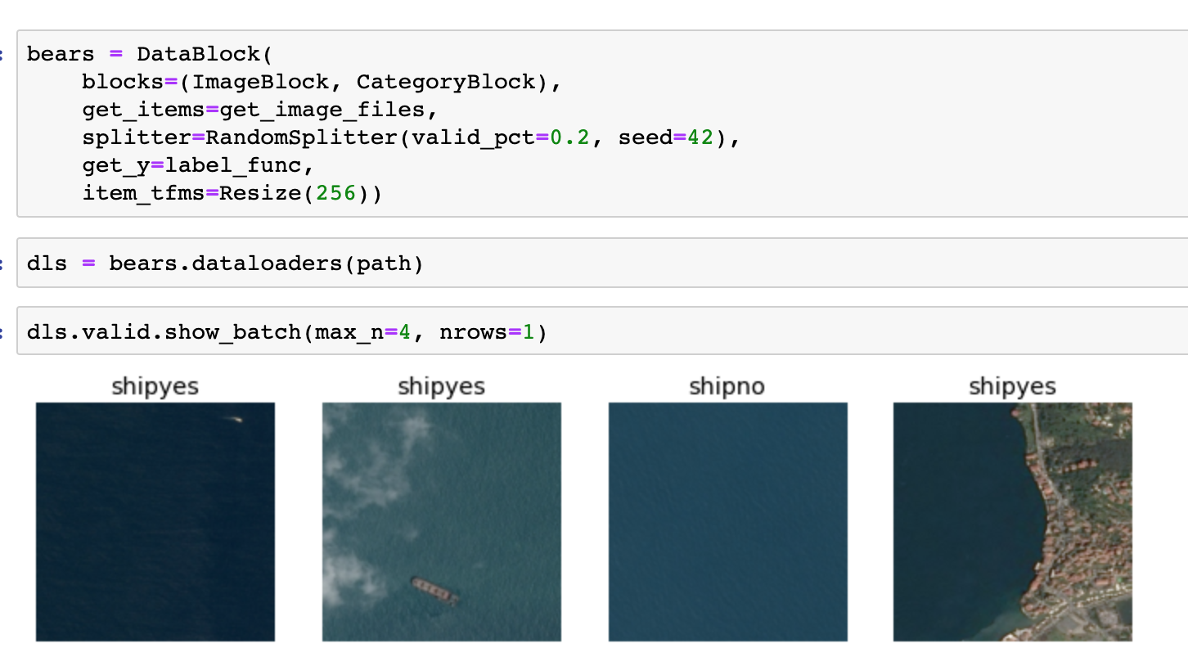
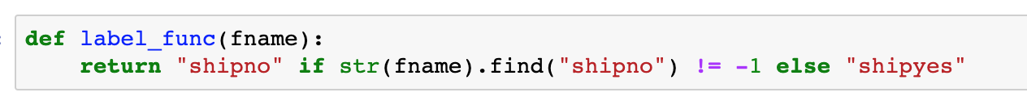
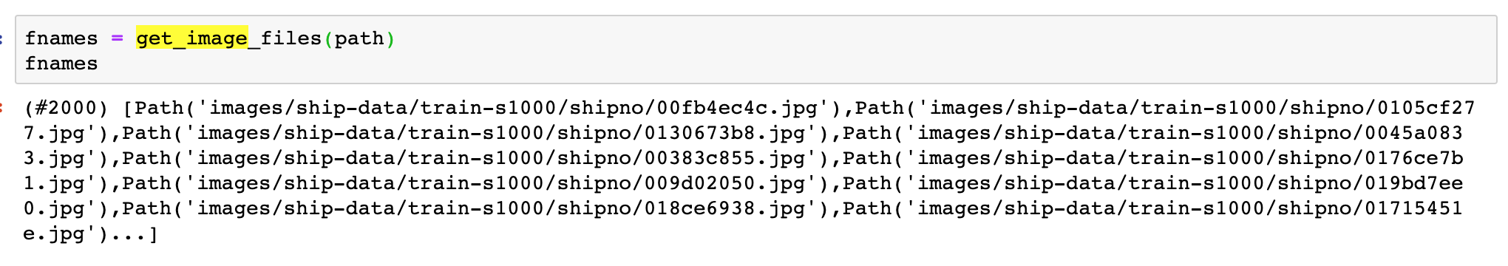
DataBlock & DataLoader

Slide 4
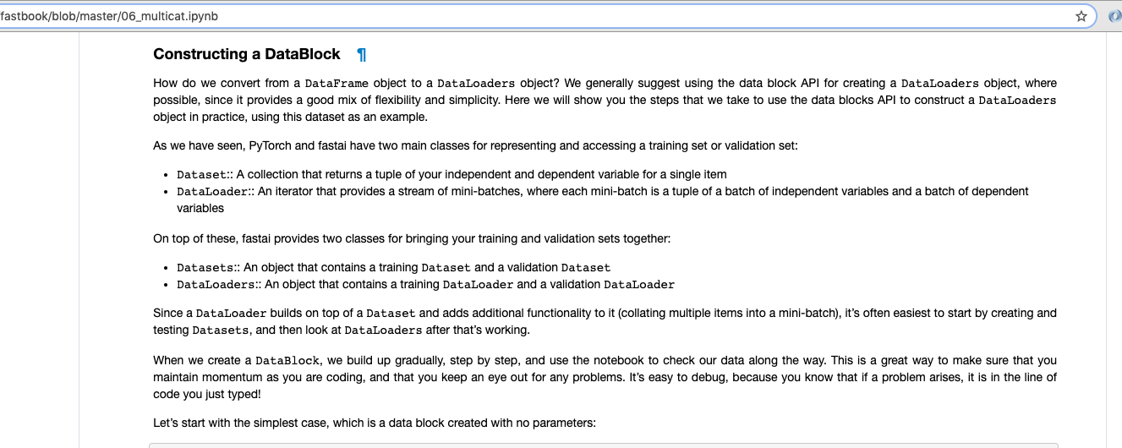
DataBlock, DataBlocks, DataLoader, DataLoaders, …

Slide 5
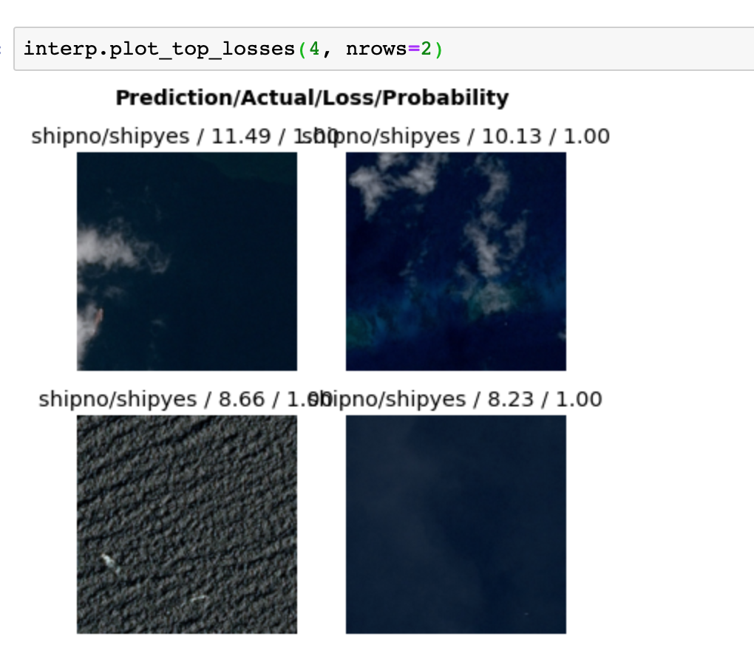
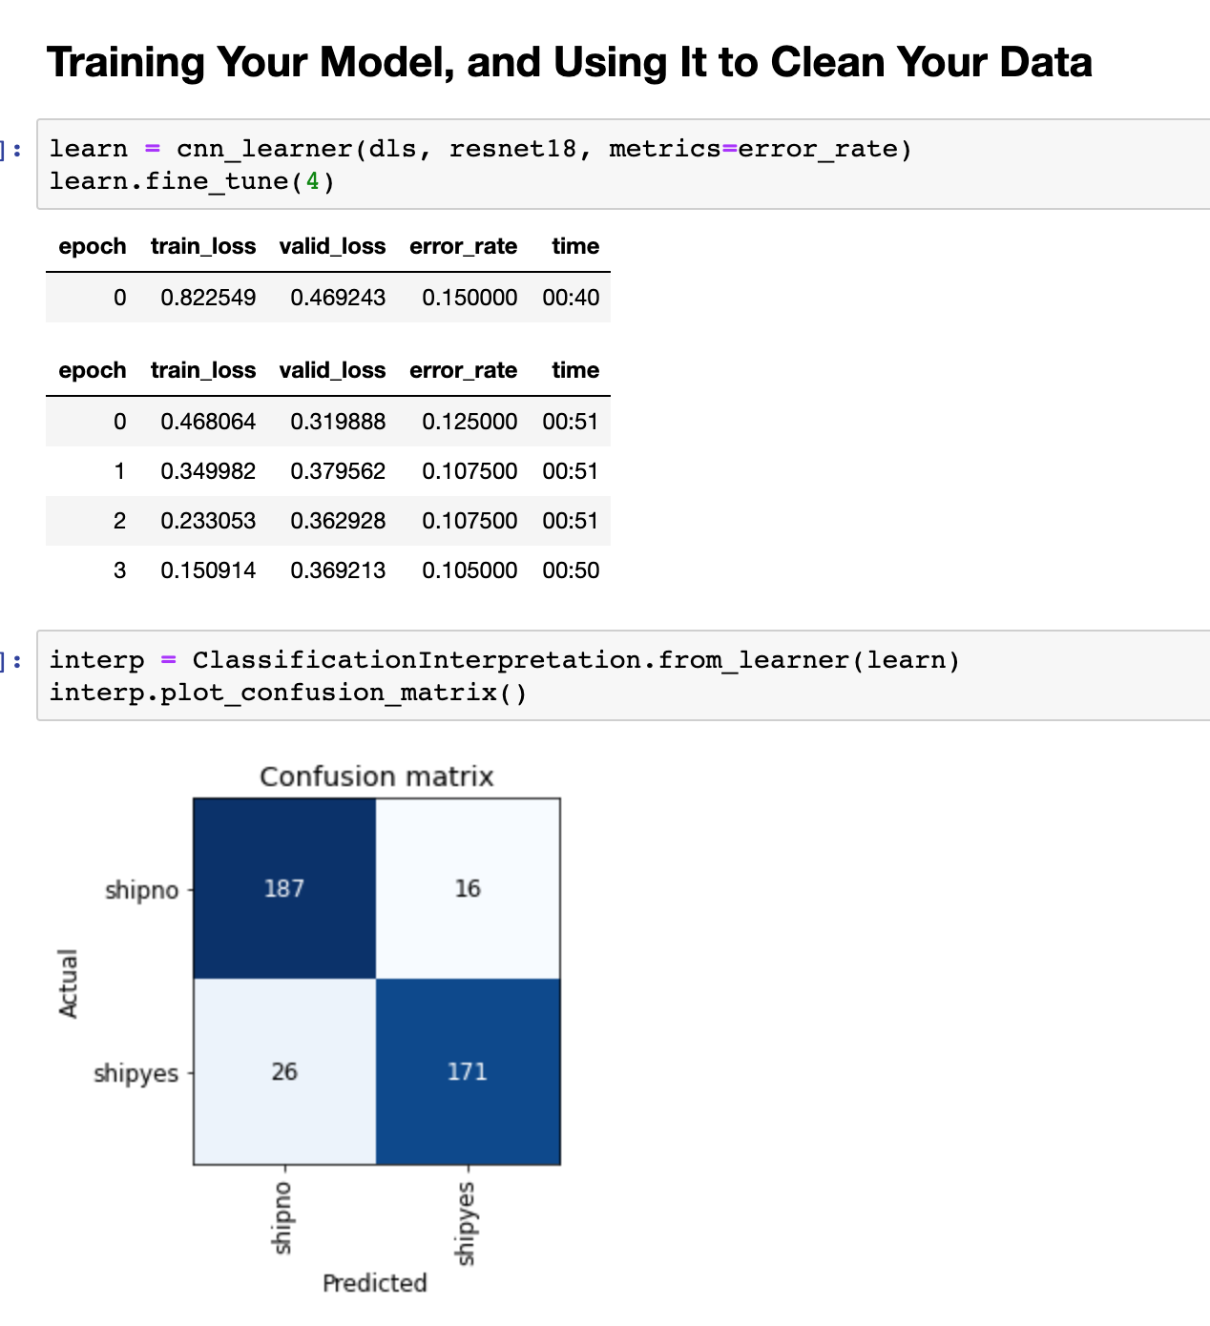
Train/Tune 1K + 1K Images (shipyes+shipno)

Slide 6
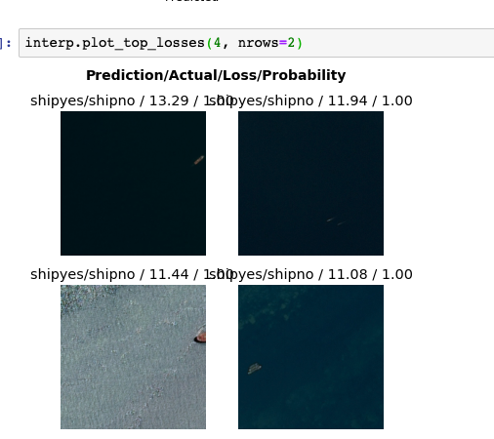
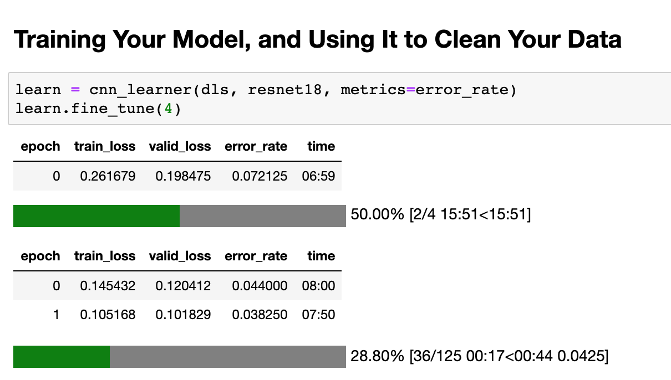
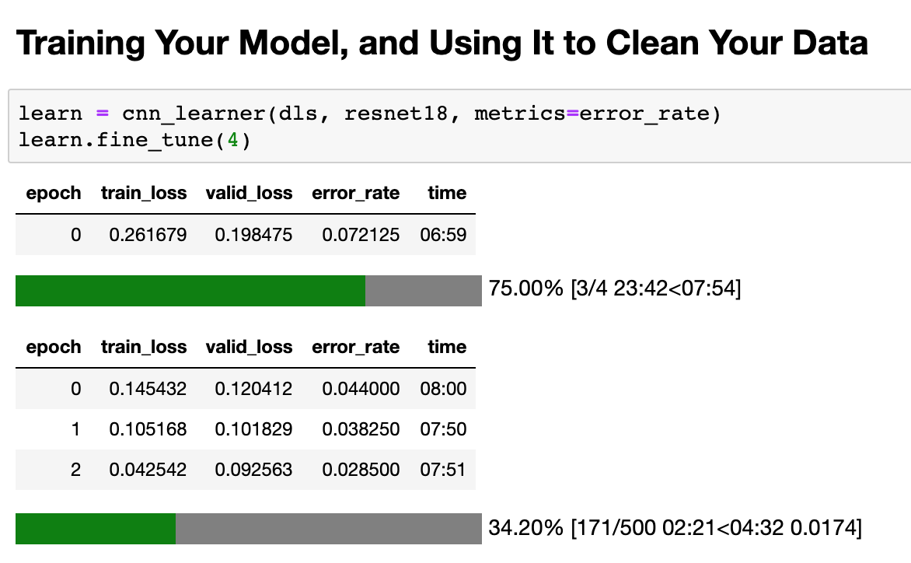
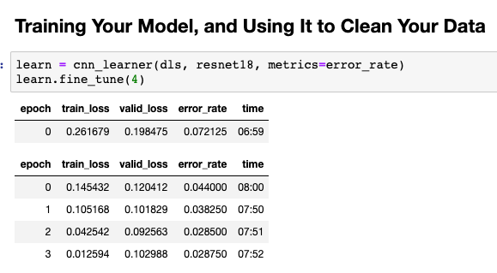
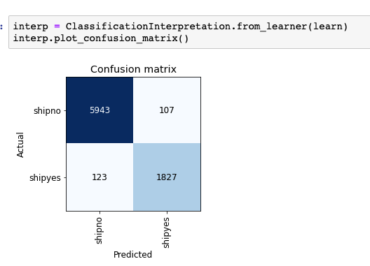
Train/Tune 10K + 30K Images

Slide 7
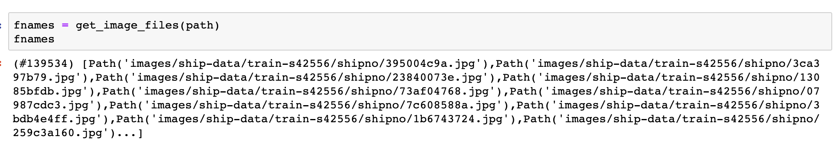
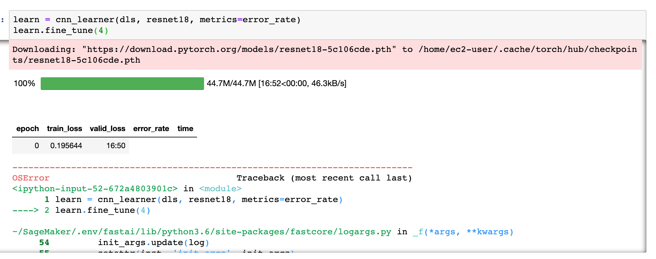
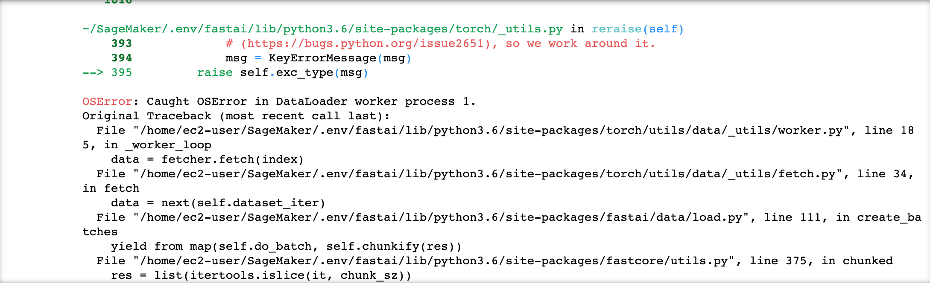
Train/Tune 139K Images

